Slide 1










Table of
Contents
18 November 2025
Easy Up
A Portable Sit-to-stand assistant easing joint stress for the elderly (SDG 3).
Presented by: T17A – Group E

Slide 2



















27 July 2077
Table of
Contents
Presented by: T17A – Group E
Notes:
https://www.freepik.com/free-ai-image/photorealistic-timber-house-interior-with-wooden-decor-furnishings_152371631.htm

Slide 3


The
Problem
Your super-duper awesome mission goes right here. 10x your PPT skills with One Skill.
One Skill
PPT Connoisseur

Slide 4
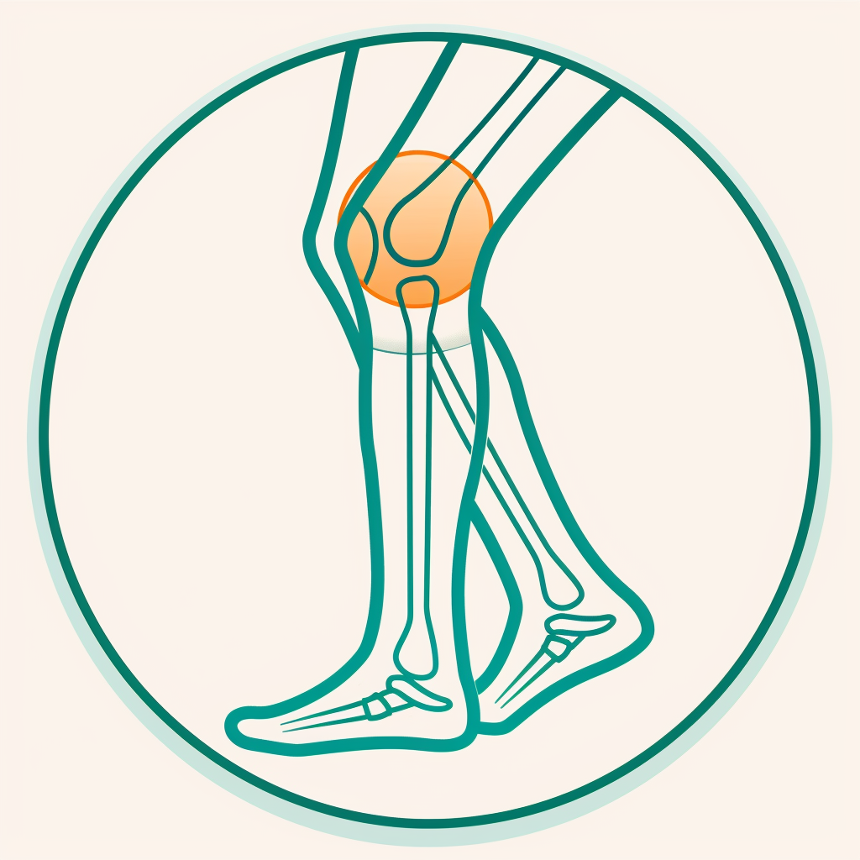
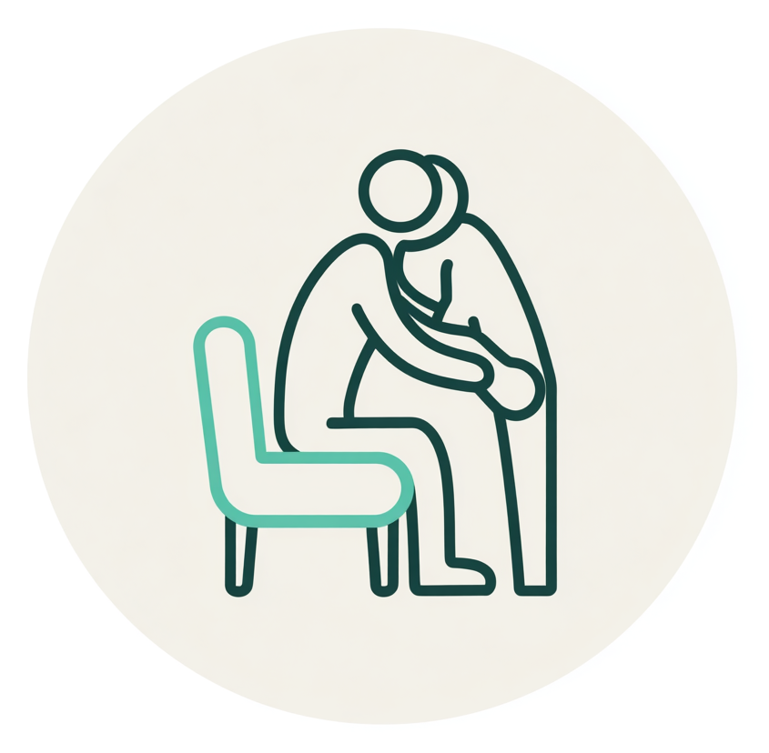

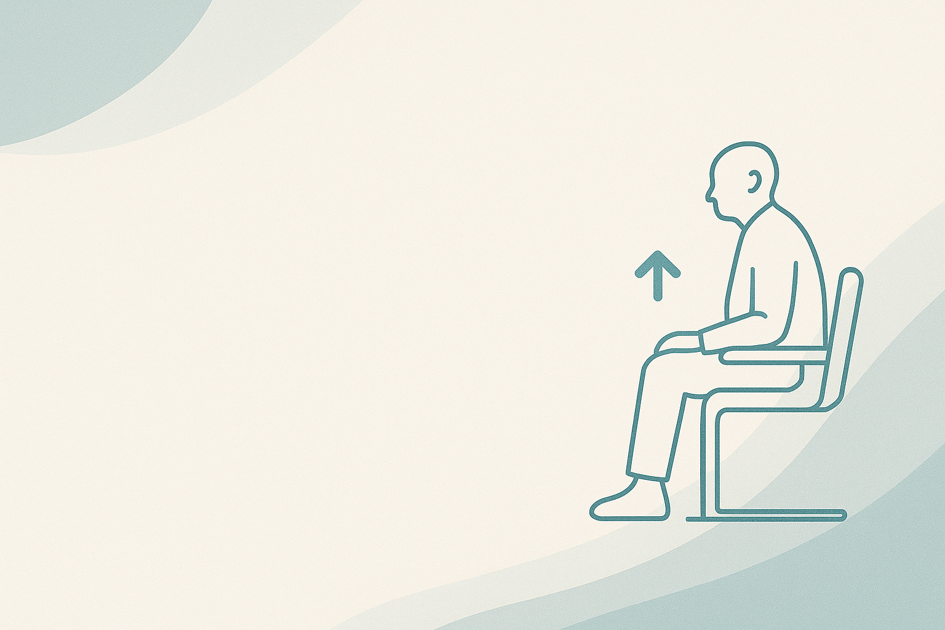
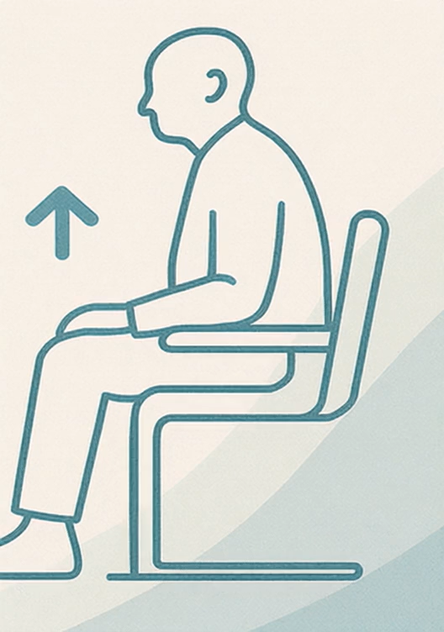
87%
93%
97%
pain causes from knee/hip discomfort when standing up from a chair.
of elderly have rely on armrests or another person to help them stand.
would like a safer, easier way to stand up independently.
The Problem
Adults go through the STS maneuver 30 -70 times a day
65% of older adults report chronic musculoskeletal pain
Notes:
“65% of older adults…”
https://agsjournals.onlinelibrary.wiley.com/doi/10.1111/jgs.12848?utm_source=chatgpt.com
https://pmc.ncbi.nlm.nih.gov/articles/PMC8666269/

Slide 5
Problem
>70%
<50%
97%
of adults with knee osteoarthritis report increased pain or difficulty specifically when rising from a chair.
Of older adults require support from armrests, hands, or another person to stand up
would like a safer, easier way to stand up independently.
1 in 5 elderly feel pain from lower back to knee from standing up from chairs everyday…
High repetitive load put pressure on hips, knees, shoulders.
Hard to mobility and higher risk from other injuries.
Notes:
2. “Up to ~50% of older adults rely on arm support or another person to stand”
Source: Janssen, W. G. M., et al. (2002). Determinants of sit-to-stand ability in the elderly. Archives of Physical Medicine and Rehabilitation. 🔗 https://doi.org/10.1053/apmr.2002.33115
“>70% of adults with knee osteoarthritis report pain during the sit-to-stand movement”
Source: Mundermann, A., et al. (2014). Knee loading during the sit-to-stand movement and its association with pain in people with knee osteoarthritis. Osteoarthritis and Cartilage. 🔗 https://doi.org/10.1016/j.joca.2014.01.004

Slide 6



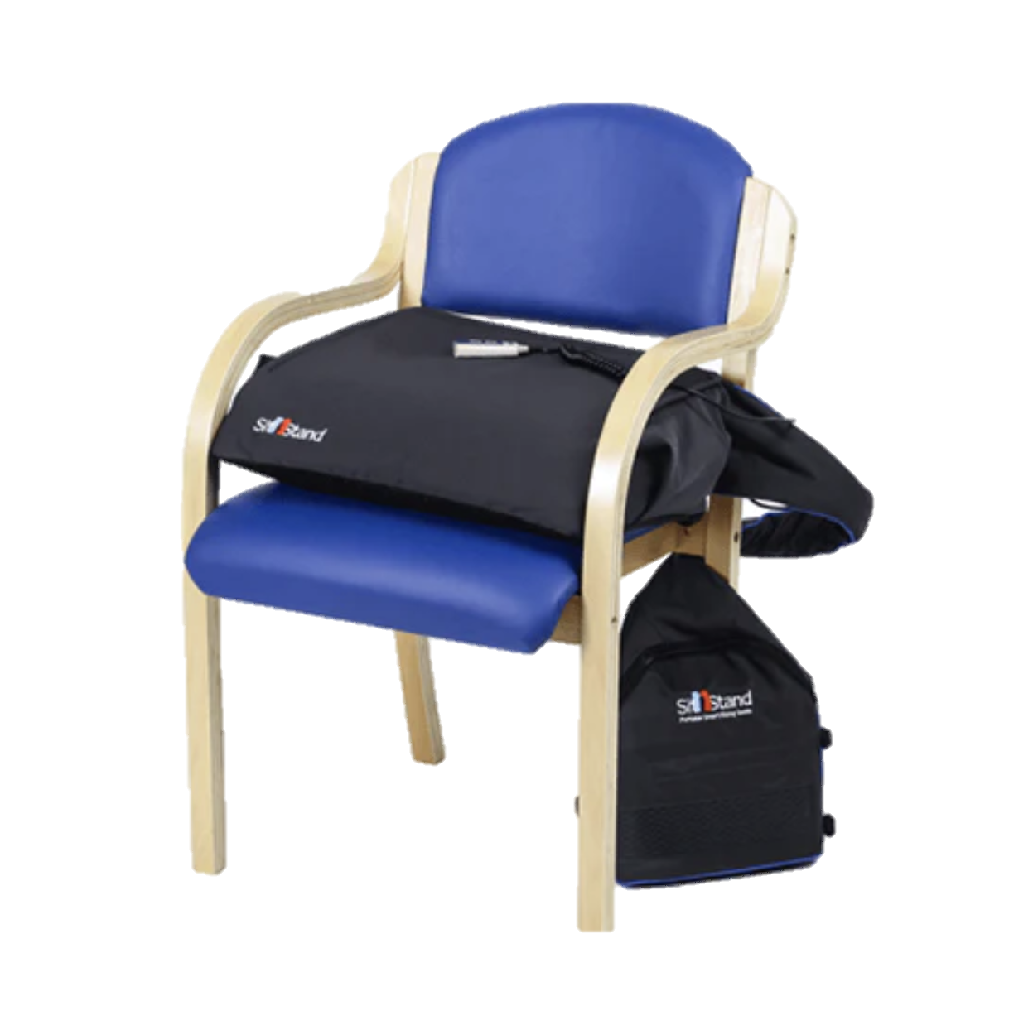
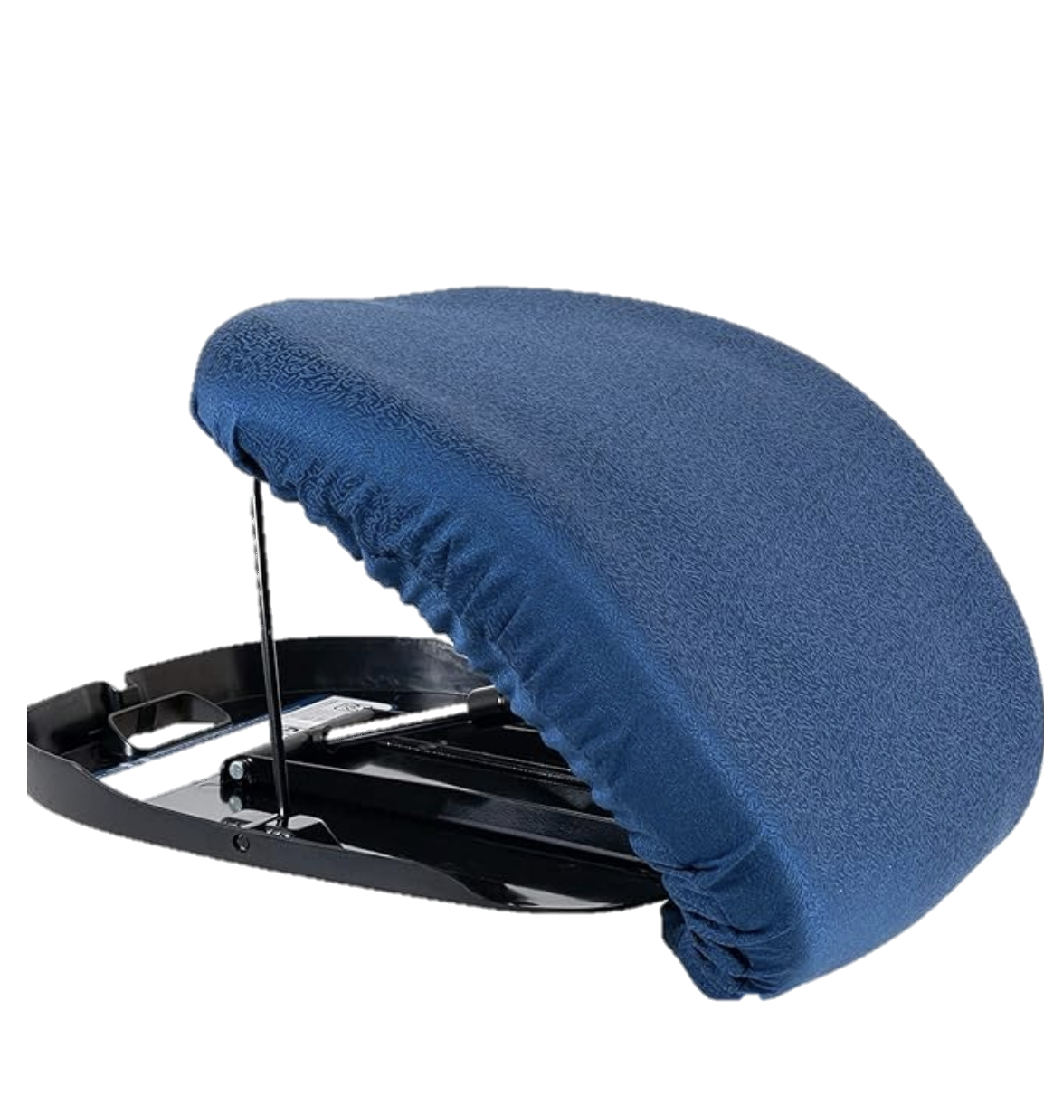
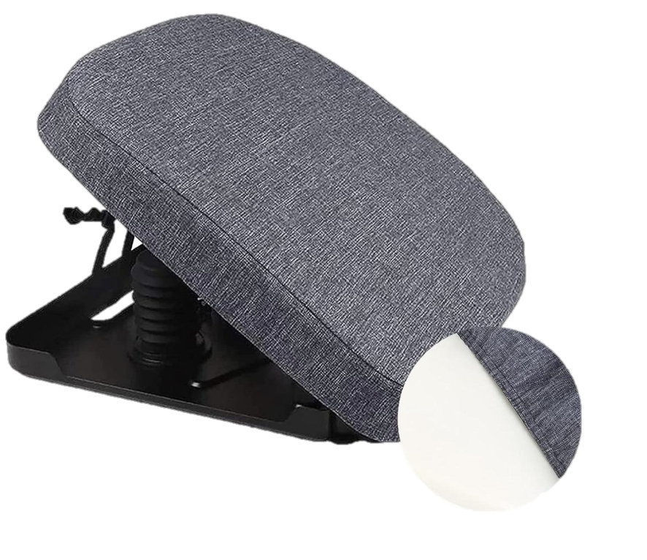
Existing Solutions
Existing solutions
SitnStand Lift Assist
$1299 AUD
Carex Uplift Seat Assist
$247.52 AUD
Manual Lift Cushion $469.99 US
Battery‑powered vertical lift with a two‑button remote.
Highly portable
High cost
Needs regular recharging
Heavy and complex
Non‑electric pneumatic seat that lifts up-to 50 % of the user’s weight
Adjustable height.
Budget friendly
Bulky and unsafe.
Hard to close down.
Manually actuated seat providing up to 70 % lift assistance and supports users up to 130kg.
Adjustable weight range
Washable polyester cover.
Mid‑range price
Weight about 4.5 kg
Manual activation requires effort.

Slide 7
Existing solutions
SitnStand Lift Assist
$1299 AUD
Carex Uplift Seat Assist
$247.52 AUD
Manual Lift Cushion $469.99 US
Battery‑powered vertical lift with a two‑button remote.
Highly portable
High cost
Needs regular recharging
Heavy and complex
Non‑electric pneumatic seat that lifts up-to 50 % of the user’s weight
Adjustable height.
Budget friendly
Bulky and unsafe.
Hard to close down.
Manually actuated seat providing up to 70 % lift assistance and supports users up to 130kg.
Adjustable weight range
Washable polyester cover.
Mid‑range price
Weight about 4.5 kg
Manual activation requires effort.
Notes:
On the Existing Solutions slide you want the viewer to very quickly understand what each competing device is, what it does well, where it falls short, and why your concept is different. Right now you only show a photo and the price; consider adding concise labels and a few key facts for each:
Name & type – Identify the product and its lift mechanism. For example: • SitnStand Lift Assist Compact – a battery‑powered “lift chair in a bag” with vertical‑lift air bladders and a two‑button remote. • Carex Uplift Seat Assist – a non‑electric pneumatic seat that gently lifts up to 70 % of the user’s weight. • Manual Lift Cushion (GoSupps/WZDMZYL) – a self‑powered hydro‑pneumatic cushion with adjustable weight settings up to 340 lb.
Key specs – Show capacity, weight and how it’s powered. For instance, note that the SitnStand weighs ~3 kg and runs on a rechargeable battery, while the Carex seat is spring‑assisted and doesn’t need electricity; the GoSupps cushion uses a gas spring and folds to 48 × 43 × 5 cm.
Pros & cons – Summarise one or two strengths and weaknesses per product. Examples: • SitnStand: portable and comfortable but high price and needs regular charging. • Carex: affordable and non‑electric, but heavy to move and still requires significant upper‑body strength. • Manual Lift Cushion: supports heavy users and doesn’t require power, but it’s bulky (≈4.2 kg) and raises the seat height, reducing legroom.
User feedback – If you have space, include a star rating or a statistic from reviews (e.g., 3.4/5 average rating on one model) or a brief quote highlighting issues such as discomfort or the need for arm strength.
Positioning graphic – A simple 2×2 matrix or icons comparing price vs portability can visually reinforce where each product sits and hint at the gap your design fills.
Ending with a short “Gap in the Market” call‑out (e.g., “No portable, adjustable cushion that offers smooth lift without heavy batteries or high price”) will set up the segue into your own solution.

Slide 8

Our Mission
Our Mission
Design and Engineer
A simple mechanism that reduces load on knees, hips and lower back
Our Mission
Restore Confidence and Independence
Enable older adults to stand up safely on their own, reduce reliance on carers and diminish the fear of falling.
Accessibility
Use affordable materials, efficient manufacturing and modular parts to reduce cost and ensure ease of use.

Slide 9
Our Mission
Design and Engineer
A simple mechanism that reduces load on knees, hips and lower back
Our Mission
Restore Confidence and Independence
Enable older adults to stand up safely on their own, reduce reliance on carers and diminish the fear of falling.
Accessibility
Use affordable materials, efficient manufacturing and modular parts to reduce cost and ensure ease of use.
Notes:
Our mission as DESN2000 UNSW students is to create a portable, joint-friendly sit-to-stand assist device that reduces knee, hip and back load, restores confidence and independence for older adults, and is affordable and practical for everyday homes.

Slide 10
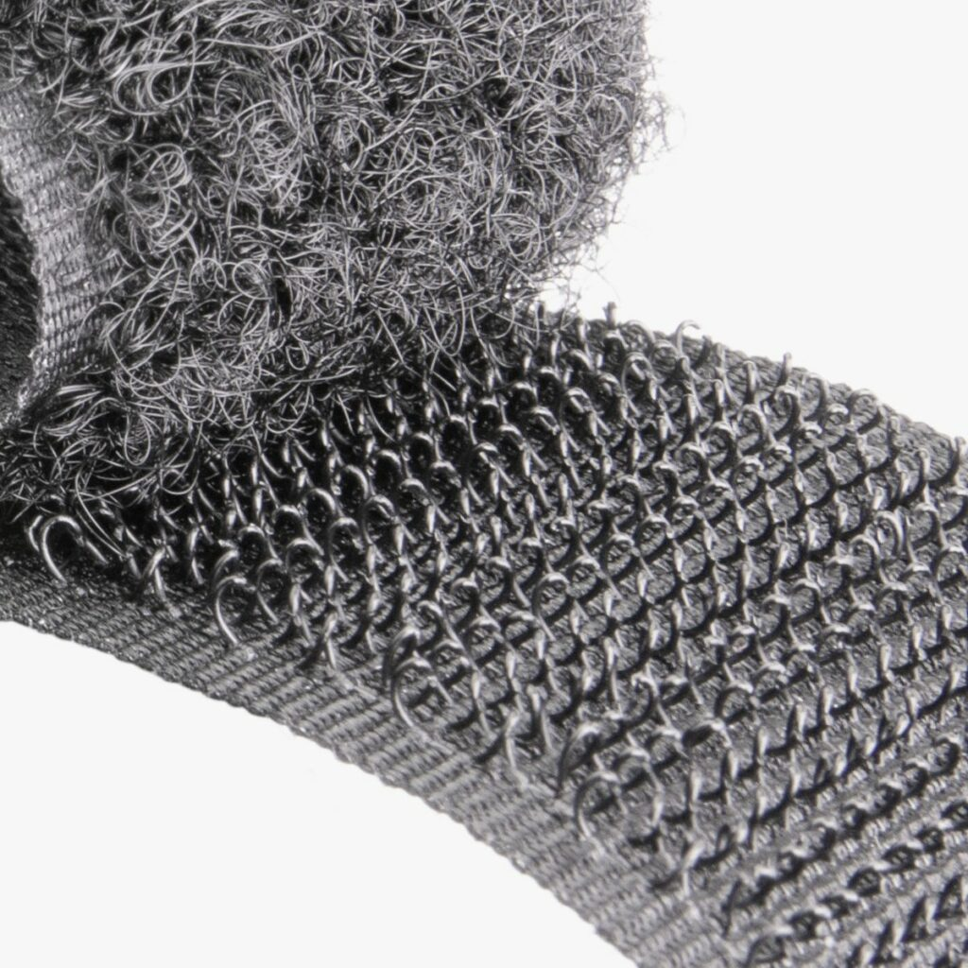
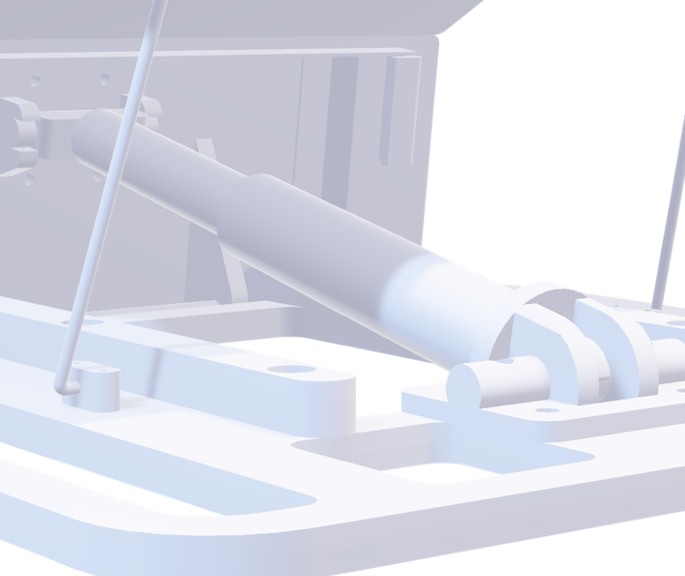
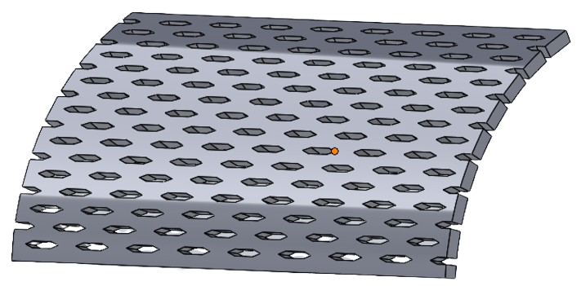
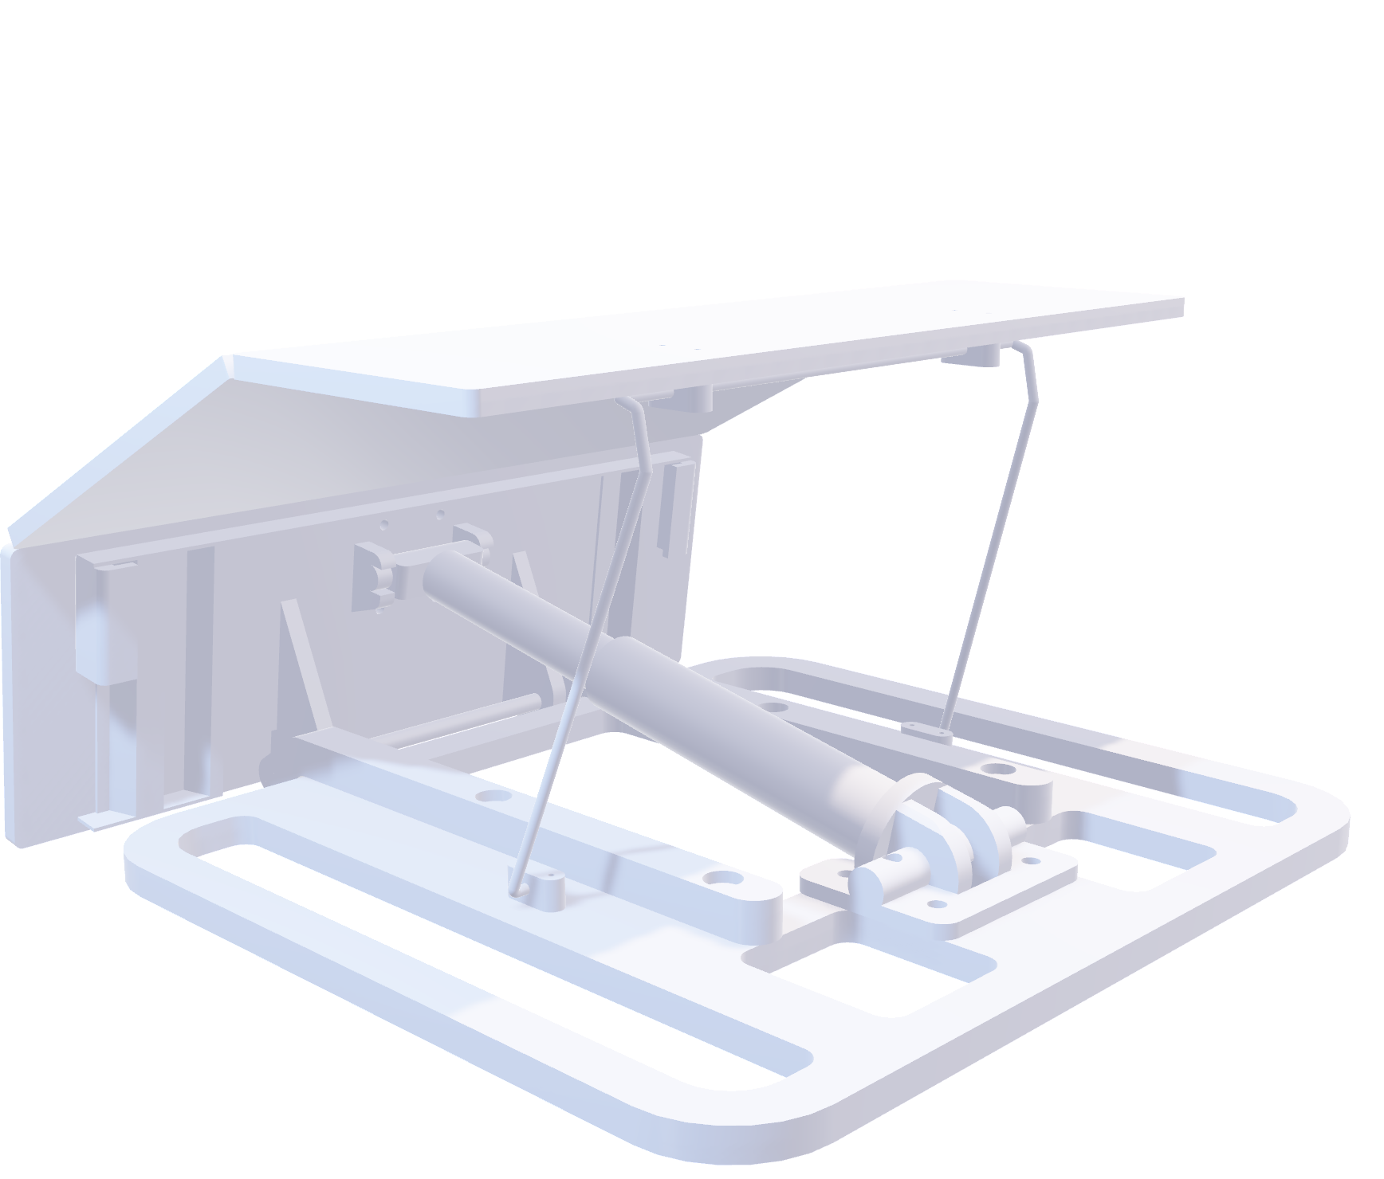


Our Solution
Easy-Up CAD Model
$$AUD \$189$$
$≈$3.5 kg
Low Cost
Removable Cushion
Lightweight
2
Piston
Living Hinge

Slide 11

Easy-Up CAD Model
$$AUD \$189$$
$≈$3.5 kg
Low Cost
Removable Cushion
Lightweight
2
Piston
Living Hinge

Slide 12
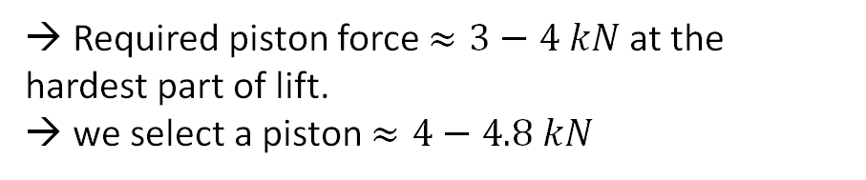
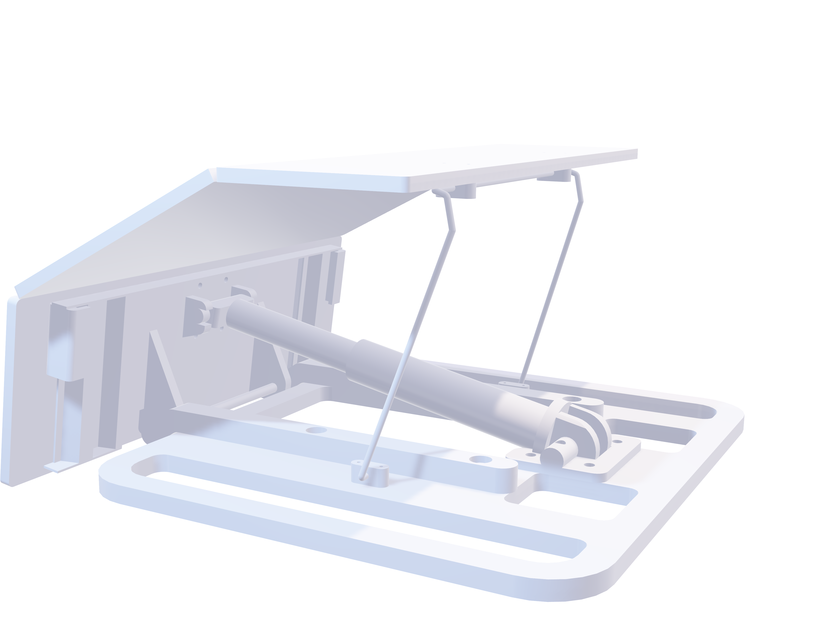
Easy-Up CAD
How the Lift Works:
→ Required piston force $≈3−4 kN$at the hardest part of lift. → we select a piston $≈4−4.8 kN$
Our device uses a gas spring (piston) mechanism to assist the sit-to-stand motion.
The piston generates an upward torque on the seat, reducing how much force the user must push with their legs.
Provides roughly 40–50% of lift assistance for a typical user.
Why a gas spring?
Self-powered : no battery, no cables.
Built-in damping : smooth, controlled rise.
Compact & enclosed : easy to package under the seat, no exposed coils.
4.8 kN

Slide 13
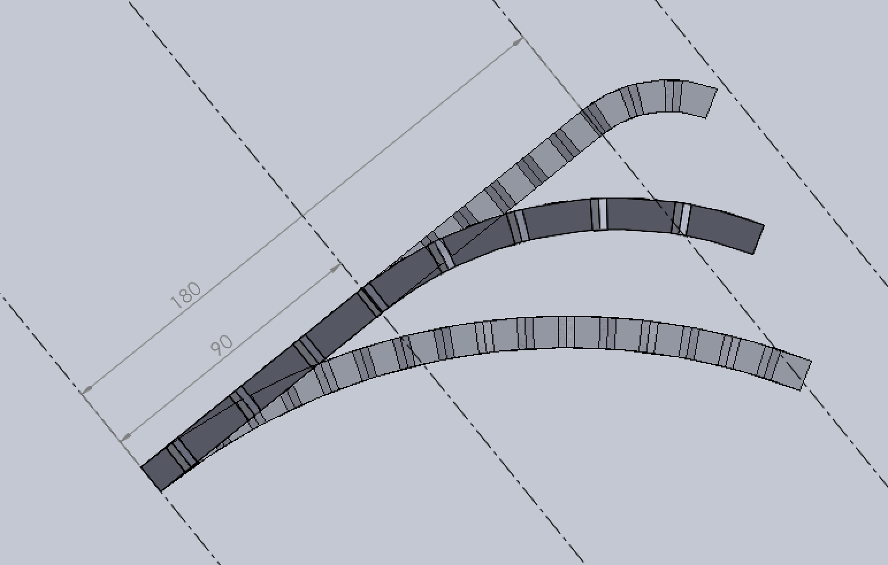
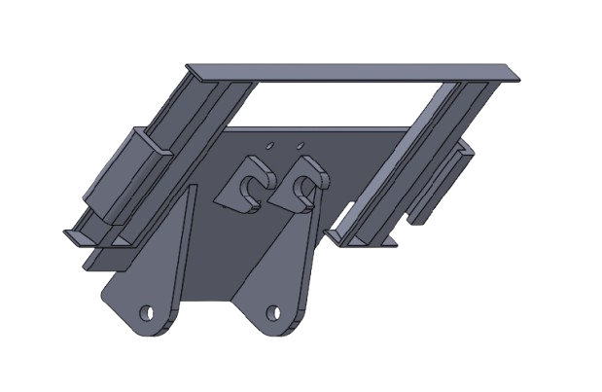
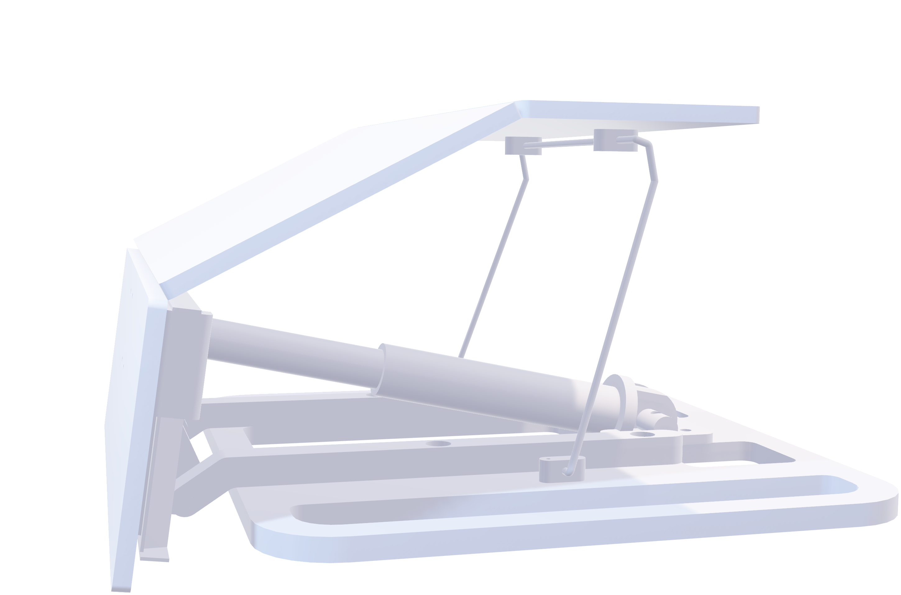
Easy-Up CAD
a) PE plastic component with limited ability to bend. - Unibody design improves durability - Cheap to mass produce
b) Sliding plate mechanism that partially supports the hinge. - Seat height profile is adjustable for comfort.
Living Hinge Component:
Expected working stress of 20.11 mPa when supporting a weight of 80kg
- FOS of 1.65 when user is within the 80kg weight limit, ensuring the hinge will not deform/snap under day-to-day use.
b) Model of sliding plate mechanism
Simulated bend at 0, 90, 180mm of plate interference
a) Model of living hinge

Slide 14
Materials Analysis
We're well positioned to win in this market.
Top
LOGO
LOGO
Left
Right
LOGO
LOGO
Bottom

Slide 15
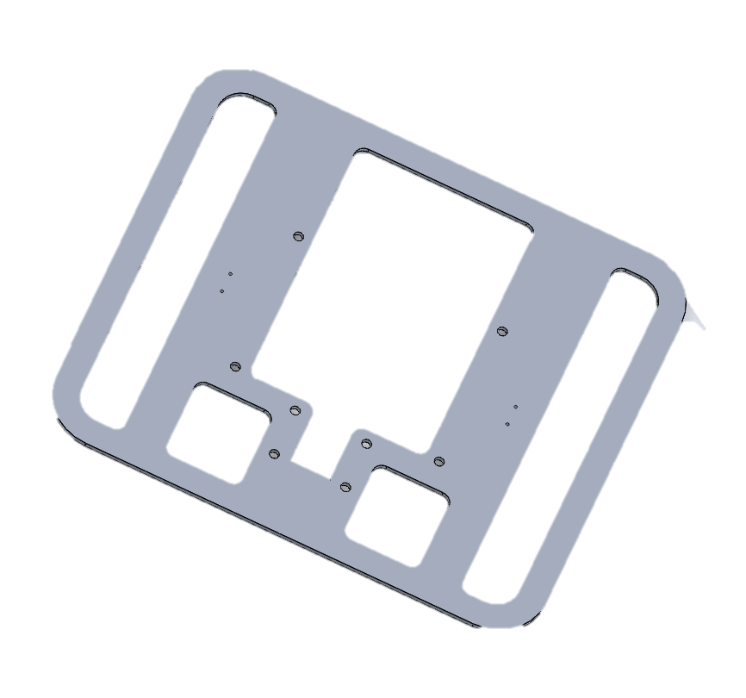
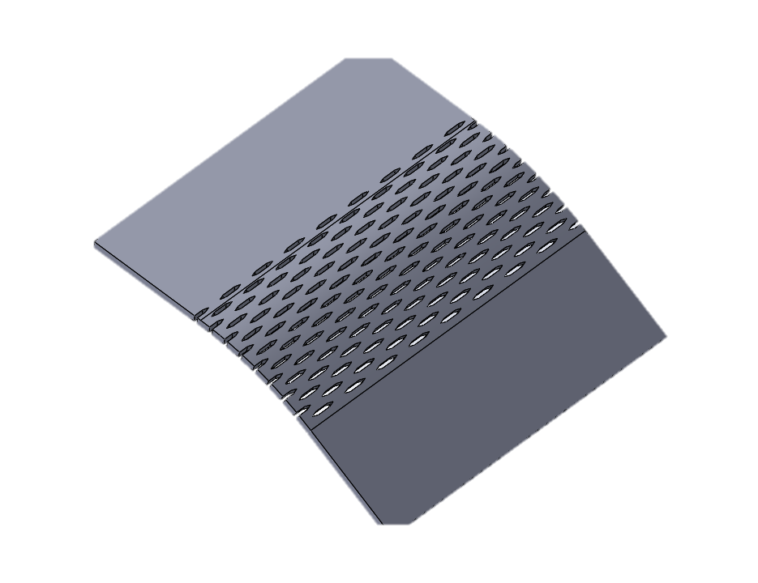
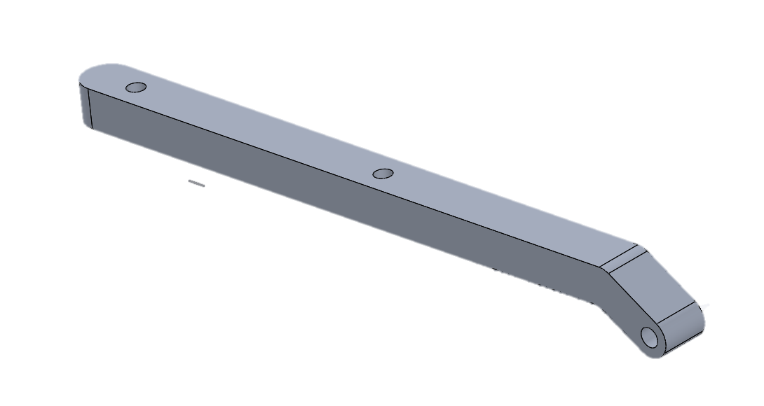


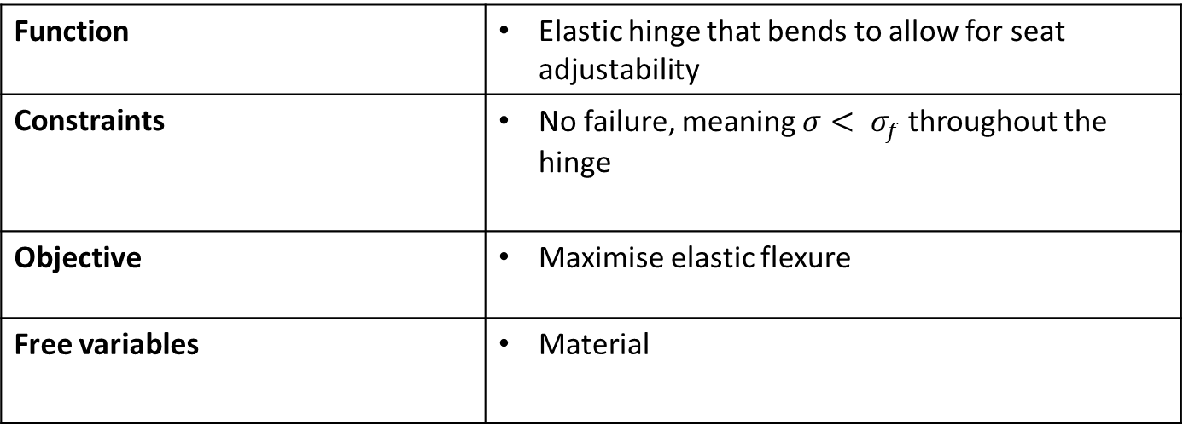
Material Analysis
Seat Hinge
Base Plate
Seat
Frame
Function | Elastic hinge that bends to allow for seat adjustability
Constraints | No failure, meaning $σ< σ_{f}$throughout the hinge
Objective | Maximise elastic flexure
Free variables | Material
Minimize R Maximise $\frac{σ_{f}}{E}$.
$M= \frac{σ_{f}}{E}$.
To remain under $σ_{f}$ :
$${R> \frac{t}{2}\left[\frac{E}{σ_{f}}\right]}_{ }$$

Slide 16
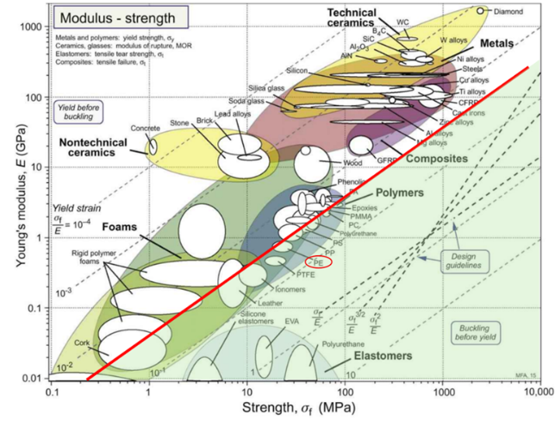

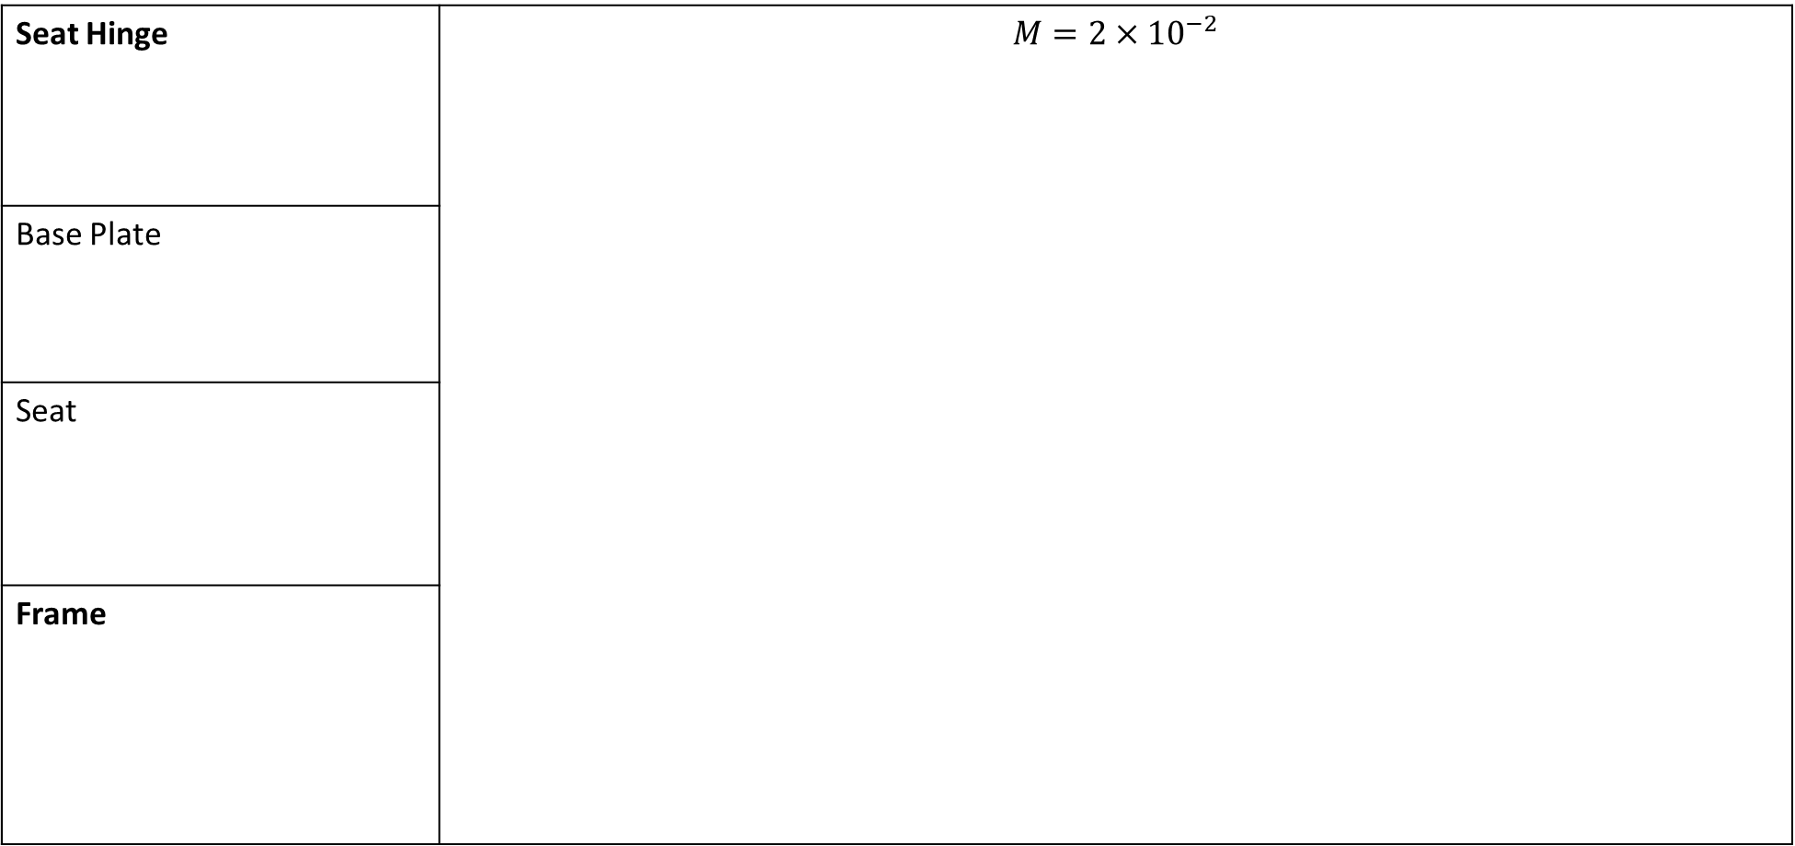
Material Analysis
Seat Hinge | $$M=2×{10}^{−2}$$
Base Plate
Seat
Frame
$$M=2×{10}^{−2}$$
Polyethylene:
M = 32
Polypropylene:
M = 30
Elastomer:
M = 100 – 1000
High-strength Copper Alloys: M = 4

Slide 17
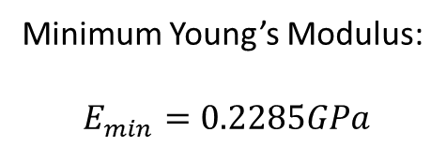
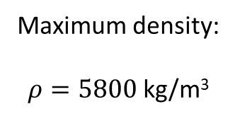
Material Analysis
Seat Hinge
Base Plate
Seat
Frame
Function | Support load of mechanism with the user
Constraints | Must be lighter than 3kg Must support 50kg
Objective | Maximise stiffness
Free variables | Thickness Material
Maximum density:
$ρ=5800$ kg/m³
Minimum Young’s Modulus:
$$E_{min}=0.2285GPa$$

Slide 18
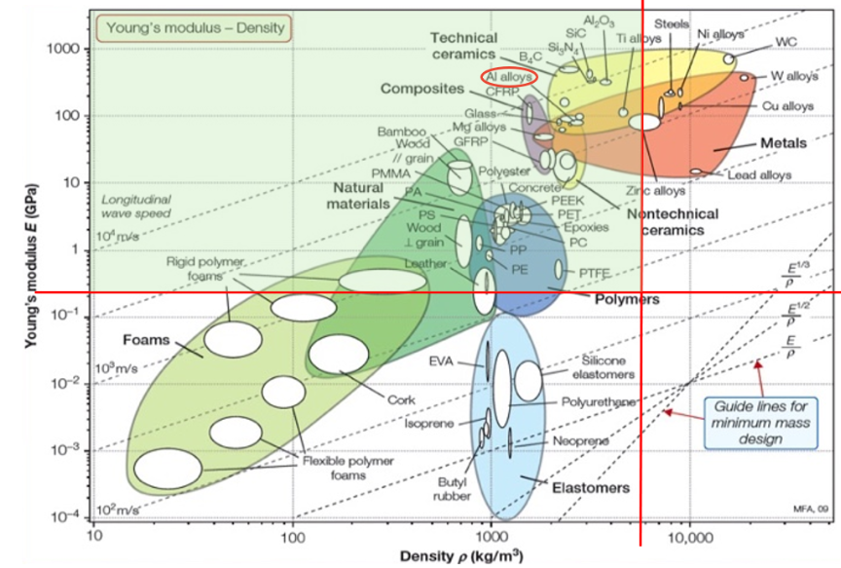


Material Analysis
$$ρ_{max}=5800$$
Seat Hinge
Base Plate
Seat
Frame
Woods/ Bamboo:
Needs screw insert
Polymers:
Lighter, but lowers
stiffness and more
expensive
Aluminium Alloys:
Higher stiffness,
cheaper
$$E_{min}=$$
$$0.2285$$

Slide 19


Material Analysis
Seat Hinge
Base Plate
Seat
Frame
Function | Support the load of the mechanism along with the user
Constraints | Dimensions are 450mm by 425mm by 8mm
Objective | Maximise stiffness Minimize mass
Free variables | Material
Mass Equation:
$$m={\left(\frac{12 S^{∗}}{C_{1}b}\right)}^{\frac{1}{3}}(bL^{2})\left(\frac{p}{E^{1/3}}\right)$$
To maximise stiffness and minimize mass:
$M= \frac{E^{\frac{1}{3}}}{ρ}$.

Slide 20
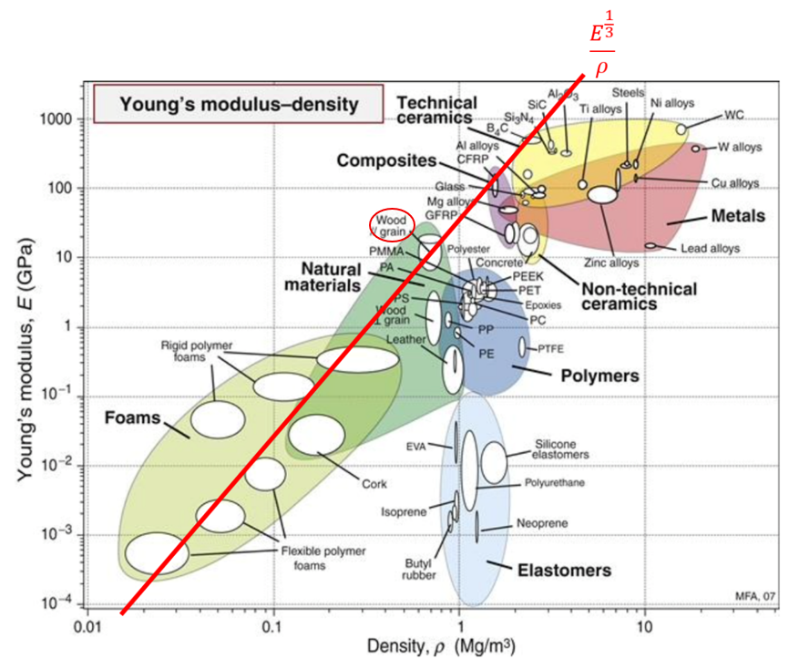
Material Analysis
Seat Hinge
Base Plate
Seat
Frame
Wood:
M = 0.00315
Steel:
M = 0.000750
CFRP: M = 0.003321

Slide 21
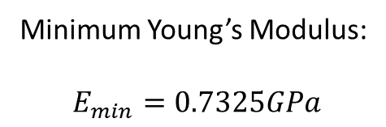
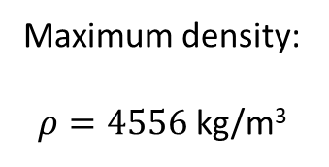
Material Analysis
Seat Hinge
Base Plate
Seat
Frame
Function | Support load of mechanism with the user
Constraints | Dimensions are 450mm by 425mm by 8mm Must be lighter than 0.8kg Must support 50kg
Objective | Maximise stiffness
Free variables | Material choice
Maximum density:
$ρ=4556$ kg/m³
Minimum Young’s Modulus:
$$E_{min}=0.7325GPa$$

Slide 22
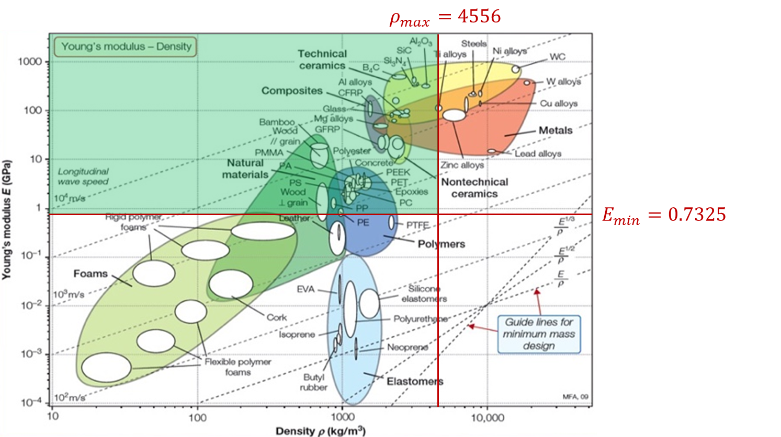
Material Analysis
Seat Hinge
Base Plate
Seat
Frame
Woods/ Bamboo:
Cannot screw/ need a screw insert.
Polyester:
3.8 – 4.3US$/kg,
Magnesium Alloys:
3.1-3.4US$/kg more expensive,
lighter but has lower stiffness.
Aluminium Alloys:
2.1-2.3US$/kg. Higher stiffness and cheaper.

Slide 23




Fasteners
Key metrics
$97M+
x10
78%
Provide more information about this key performance indicator.
Provide more information about this key performance indicator.
Provide more information about this key performance indicator.
99%
770K+
$1.7M
Provide more information about this key performance indicator.
Provide more information about this key performance indicator.
Provide more information about this key performance indicator.

Slide 24
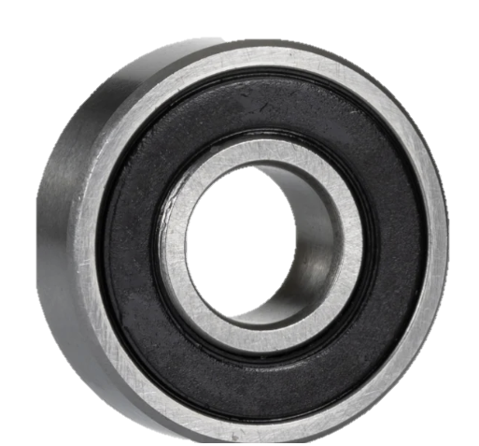

Fastener
Bearing analysis
Calculation of expected of life
$$L= \frac{60 n L_{n}}{{10}^{6}} millions rev$$
$$= \frac{(60)(10)(87600)}{{10}^{6}}=52.52 millions rev$$
2. Selection of bearing types: 10BC02
$$C_{0 }=224 kgf$$
$=2240 N$
$$C=400 kgf$$
$=4000 N$ 3. Calculate of Equivalent load:
$$C=400 kgf$$
$$=4000 N$$
$$P=\left(XF_{r}+YF_{a}\right)S$$
= ((1)(980)+0)1.2)
= 1176 N

Slide 25
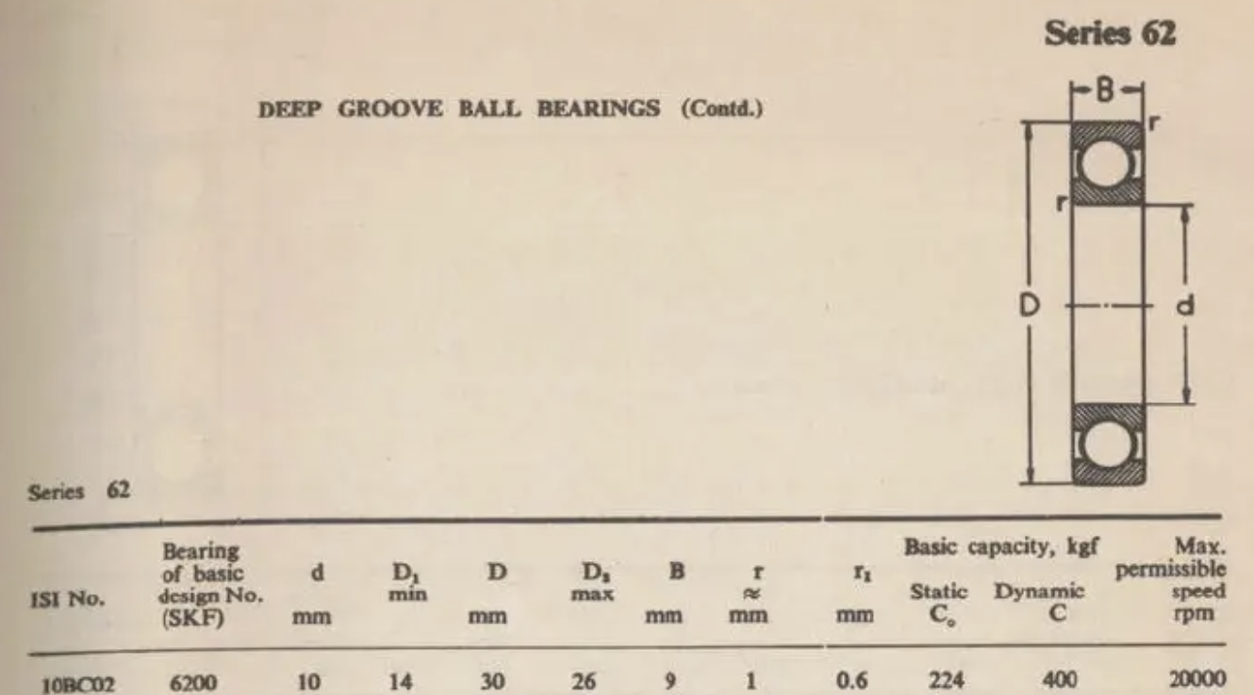

Fastener
4. Expected life comparison
$$C={P \left(\frac{L}{1}\right)}^{3/10}$$
$$4000={1176 \left(\frac{L}{1}\right)}^{3/10}$$
Rearranging to get L gives:
$$L=59.18$$
Since L is greater than the expected life:
59.18 mil rev > 52.56 mil rev
Therefore, the bearing is safe

Slide 26
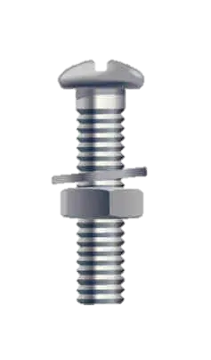
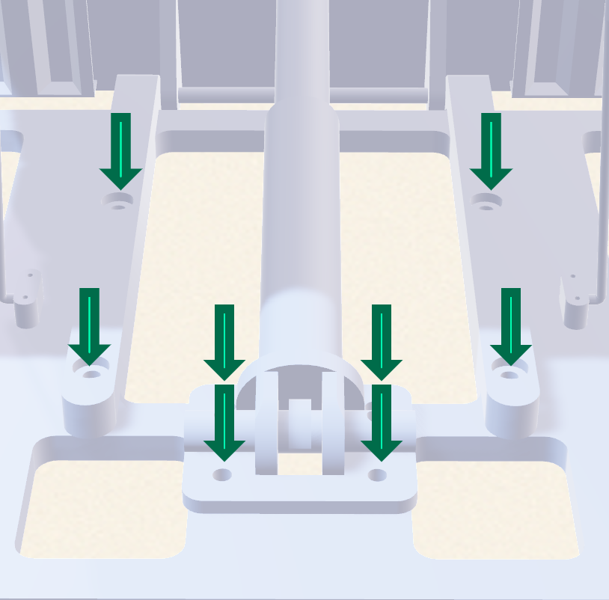
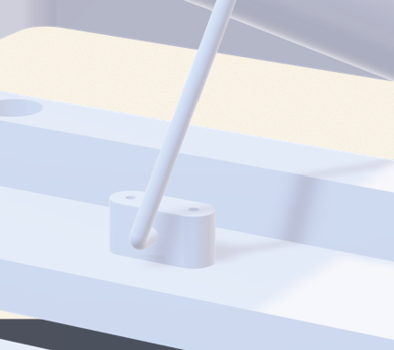
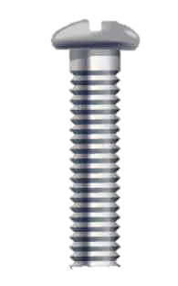

Fastener
Expected $F_{MAX}≈1kN,$FoS $≈$ 1.25
Failure Mode/ Required Force (kN)
M8x25mm (outside)
M8x12.5mm (inside)
Flat head bolt
Bolts Shear failure : 50
Bolts Bearing failure : 106
Bearing failure of members : 420
Edge shearing of members: 370
Tensile failure of members: 377
The maximum load which can carried 50 kN, which failure by bolts shear failure.
M8 Washer
M8 Nut
Bolts Shear Failure : 45
Bolts Bearing Failure : 26
Bearing failure of members : 67
Edge’s Shearing of members: 92
Tensile failure of members: 102
The maximum load which can carried 26 kN, which failure by bolts bearing failure.
M3 x 20mm
Fillister Screw
Notes:
Goal: Show assembly, safety, and maintenance have been considered.
Include:
Overview:
“Bolted connections for adjustability, maintenance, and easy assembly.”
Table:
Joint location | Fastener type (e.g. M8 bolt + locknut) | Reason.
Points to cover:
Why bolts instead of welds in certain areas (adjustability, transport).
Load paths: shear vs tension in bolts (simple sketch).
Safety measures:
Lock washers, nyloc nuts, thread locker.
Min edge distances and plate thickness.
Assembly logic:
How many different bolt sizes? (Standardising to reduce confusion.)
Tools needed (e.g. single spanner size).
Optional visual:
Exploded CAD view showing how components and fasteners come together.

Slide 27
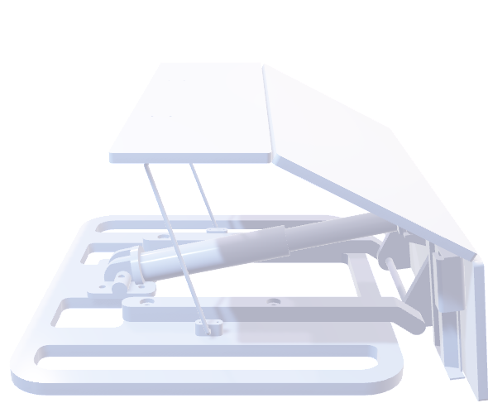
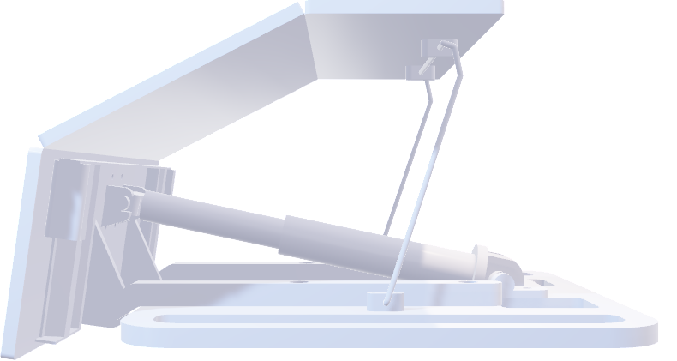

We believe the Easy-Up assist device is ready for further prototyping, to empower the lives of elderly customers.

Slide 28

Our Engineering Team
Our top experts are ready to reach the goals
Obi Wan
Han Solo
Princess Leia
Raminta Art
One Skill
CEO
CTO
CFO
CMO
PPT

Slide 29













Our Engineering Team
Thanks for listening!!!
Tony
Bao
Muneel
Quang
Sophia
Diana
Wilson

